Slide 1
Testing in TDD spirit
Test is like sex – even if it’s bad, it’s better than nothing!?
Michał Bryłka, Capgemini

Slide 2
Schedule
Day 1
Theory
The Goods
The Bads
The Uglies
Short live trainings
Day 2
Testing in TDD spirit
Breaks anyone ??

Slide 3
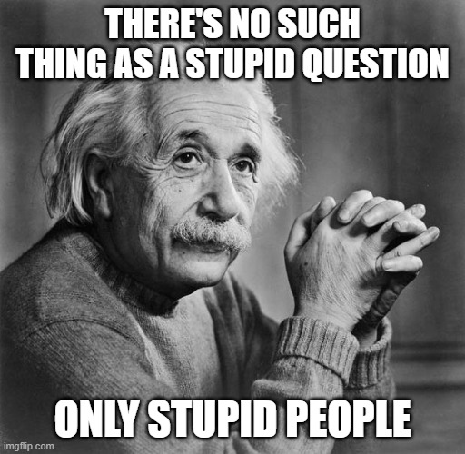
Rules

Slide 4
Agenda
Unit vs other tests
Why?
How?
Some do it better
Obstacles

Slide 5
Rules
„That all depends”
C# / .NET / Visual Studio == everything else
Key words for use in RFCs to Indicate Requirement Levels
https://tools.ietf.org/html/rfc2119
My „must” – in my team
In order to let it go, you need to possess it

Slide 6
Glossary
OUT/SUT – Object/Subject Under Test - class we are testing
Test Doubles
Mock – object with expectations
Stub - object behaving in given way
…
https://www.martinfowler.com/bliki/TestDouble.html
Lambda Expression e.g. (x,y) => x + y
Interface / contract
Dependency Injection

Slide 7
Reasons
Code works as expected ⭢ self-confidence
Regression bugs detection
Code tested ⭢ (quite often) code well designed ⭢ SOLID
Run code regardless large systems around
Mouse clicks reduction
Less debugging == happier team

Slide 8
Reasons
Legacy systems – façade + facilitating injections
Usage documentation, use case specification
No code comments anymore !!!
TDD ⭢ YAGNI
OSS – failing tests (bug manifestation)
Time capsule
Temporal proofing
Upgrade path detector
Performance guard

Slide 9
Test kinds
Logical tests
Unit test
Micro-test
Acceptance („business”) test
Funtional test (wider, mocked context)
Configuration (end-to-end) tests
Integration test
System test

Slide 10
Frameworks – (unit) tests
(x)Unit frameworks, presented on XP2000 conference (.net 1.0 - 2002!)
nUnit
xUnit
jUnit
…
MS Tests
https://en.wikipedia.org/wiki/List_of_unit_testing_frameworks#.NET_programming_languages

Slide 11
NUnit
Attributes
manage lifecycle of test (setup, tests, tear down)
providing data to the test (e.g. values, range, generators, combinatorics)
helpers (e.g. SetCulture, Category)
Assertions
Classic
Assert.AreEqual( expected, actual )
Constraint-based
Assert.That(actual, Is.EqualTo(expected) )
Warning: what is expected, what is actual - change in order will lead to misleading error messages!!!
Test Context
Names of the test, properties. Rarely used

Slide 12
NUnit
Execution order
[TestFixture] - class
[OneTimeSetUp] / [SetUp]
[OneTimeTearDown] / [TearDown]
[Test] / [TestCase] / [TestCaseSource]

Slide 13
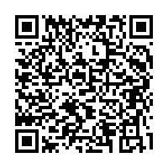
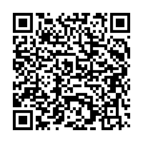
Demo
AttributesLifecycleExample
https://github.com/nemesissoft/Nemesis.TextParsers/blob/master/Nemesis.TextParsers.Tests/ExploratoryTests.cs
DataAttributesExample
https://github.com/nemesissoft/Nemesis.TextParsers/blob/master/Nemesis.TextParsers.Tests/Deconstructable/DeconstructableTests.cs

Slide 14
Demo
Bad naming
[Test] public void Hero8() { Assert.That(1+3==4);
Assert.That(3+1==4);
}
Good naming
[Test] public void AdditionShouldBeCommutative() { Assert.That(_calc.Add(1, 3), Is.EqualTo(4));
Assert.That(_calc.Add(3, 1), Is.EqualTo(4));
}

Slide 15
Demo
Bad naming
[Test] public void TestException() { try { //SomeAction() Assert.Fail(); } catch (Exception ex) { Assert.IsNotNull(ex); } }
Good naming
[Test] public void Parser_ShouldThrowUponMalformedInput() { var ex = Assert .Throws<ArgumentException>(() => transformer.Parse("Blah")); Assert.That(ex.Message, Does.Contain(expectedMessagePart));
}

Slide 16
Naming variants
AddShouldReturnProperResult
WhenAdd_ShouldReturnResultOfAddition
When_Add__Should_Return_Result_Of_Addition
Multiply_WhenTwoPositiveNumbersAreMultiplied_ShouldReturnPositiveResult
Rewriting names ?
Potential runner issues

Slide 17
Naming - rewriting names
private static IEnumerable<TestCaseData> GenericInterfaceTests() { var data = new (Type type, Type generic, bool expectedResult)[] { (typeof(List<string>), typeof(IEnumerable<>), true), (typeof(int), typeof(IEquatable<int>), true), };
return (from d in data select new TestCaseData(d.type, d.generic).Returns(d.expectedResult) .SetName($"{d.type.GetFriendlyName()} {(d.expectedResult ? "->" : "!- ")} {d.generic.GetFriendlyName()})") ).ToList();
}
[TestCaseSource(nameof(GenericInterfaceTests))] public bool ImplementsGenericInterface(Type type, Type generic) => type.DerivesOrImplementsGeneric(generic);

Slide 18
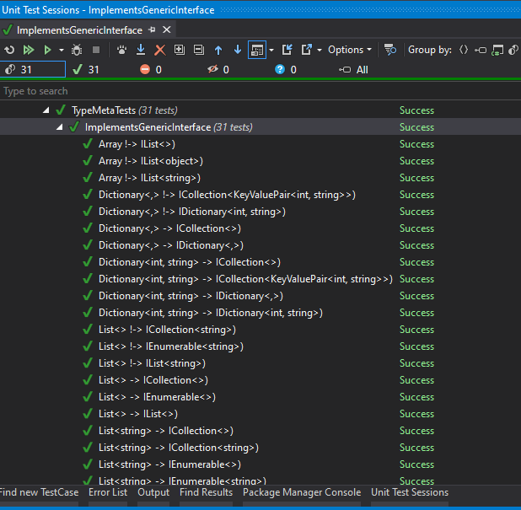
Naming - rewriting names

Slide 19
Running
Console and GUI runner
Visual Studio / RAD integration
Resharper – industry choice
Ctrl+U,Ctrl+R - runs current „context”
Ctrl+U,Ctrl+D – debug
Ctrl+U,Ctrl+U – repeat last run

Slide 20
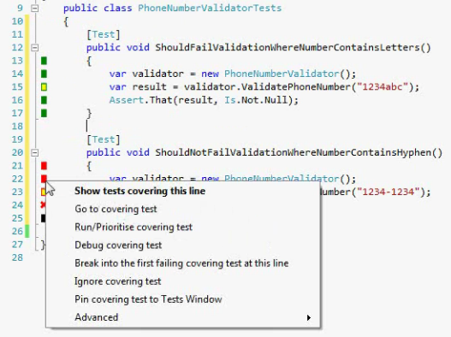
Running
In background
NCrunch (proprietary license, 160 USD)
Live Unit Test (VS Enterprise)
ContinuousTests (not under active development)
…

Slide 21
Test doubles – managing dependencies
Create mock
_dep = new Mock<IMyDependency>()
_dep = new Mock<IMyDependency>( MockBehavior.Strict )
IMyDependency actualObject = _dep.Object;
Program mock so it will behave correctly. Fluently if possible.
_dep.Setup( x => x.MyMethod( "bar" ) ).Returns( 123 )
_dep.Setup( x => x.MyMethod( "foo" ) ).Throws( new Exception( "abc123" ) )
Or alternatively just check if mock was (not) called
_dep.Verify( x => x.MyMethod( "bar" ), Times.Exactly( 5 ) )
_dep.Verify( x => x.MyMethod( "blah-blah" ), Times.Never )

Slide 22
Demo - mocks
workshop placeholder/ad

Slide 23
Moq is not your only choice !!!
FakeItEasy
Nsubstitute
Telerik JustMock Lite
Typemock - isolator
RhinoMocks – old but mellow

Slide 24
FIRST
Fast
Isolated
Repeatable
Self-verifying
Timely

Slide 25
Fast
Don't call external systems (DB, web services, files) – double them
Reduce amount of data to process to a small, representative sample
Distinguish between integration/long running and fast unit tests - run the latter ones frequently
Unit tests execution should be „instant”

Slide 26
Isolated
One reason to fail ⭢ „one” assert per test
Potential problems in external systems are eliminated
Tests don't affect each other
Beware static classes/methods, singletons, databases!
Order of test execution must not matter!
Arrange-Act-Assert*

Slide 27
Repeatable
Static data, in-memory structures not cleaned up
External systems keeping state
Non-deterministic behaviour: threads/processes/order of test executions
Other classes which failed to initialize properly due to time
Dependable / deterministic
new Random(42)
Seeded (persisted) random values

Slide 28
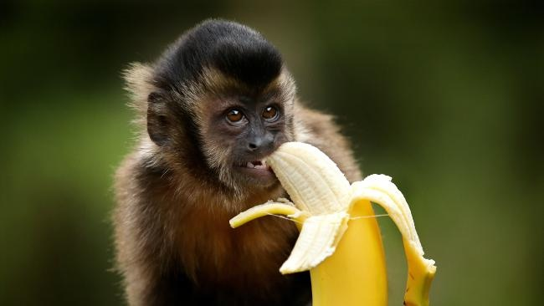
Self-Verifying
No "partial success"
No field for interpretation
user cannot be forced to read console output
Possible exception: images, patterns, science
Green (pass) == GOOD, Red (fail) == BAD
Test without assertions will often pass in most cases ;-)

Slide 29

Timely
Don't wait ages to write the test
Test-Driven Development
Test-After Development

Slide 30
AAA
Arrange
Creates "context" for the test
Use testing doubles as much as possible here
Act
One single operation we want to run using "context" prepared in Arrange part
Capture various results/side effects of operation
Assert
Test all results, with appropriate granularity
Check all side effects (expected, not allowed)

Slide 31
AAA
[Test]
public void WhenAdd_ShouldReturnResultOfAddition()
{
//arrange
var x = 10;
var y = 0.5;
var calculator = new Calculator();
//act
var result = calculator.Add( x, y );
//assert
Assert.That( result, Is.EqualTo( 10.5 ) );
}

Slide 32
AAA
[TestFixture]
public class Calculator_WhenAdd_ShouldBeCommutative { double _result1; double _result2;
[TestFixtureSetUp] public void ArrangeAndAct() { //arrange var x = 10; var y = 20.0; var objectUnderTest = new Calculator();
//act _result1 = objectUnderTest.Add(x, y); _result2 = objectUnderTest.Add((int)y, x); }
[Test] public void ShouldProduceCorrectResults() { Assert.That(_result1, Is.EqualTo(30.0)); Assert.That(_result2, Is.EqualTo(30.0)); }
[Test]
public void ShouldBothResultsBeEqual() =>
Assert.That( _result1, Is.EqualTo( _result2 ) );
}

Slide 33
Assertion styles
Assert.That(TestedMethod() == 15);
Assert.That(TestedMethod() == 15, "Method should return 15");
Assert.That(TestedMethod(), Is.EqualTo(15), "self explanatory message");
//NLP styled - Fluent Assertions: TestedMethod().Should().Be(15);

Slide 34
Assertion styles
Is.
Empty
Null
…
Iz == Is
Has.
Some.Positive
All.EqualTo(...)
…
Does.
Exist
Contain
…

Slide 35
Legacy systems
Static Methods
Facade
Seam
„Static” IoC
Composition/substitution

Slide 36
Best practices
MySystem.Tests – pattern recognized by CI/CD
[InternalsVisibleTo("*.Tests")]
[InternalsVisibleTo("DynamicProxyGenAssembly2")]
Subfolders in main solution
...and for name of test use pattern ClassName_WhenSomeMethodCalled

Slide 37
Obstacles
Hard to start writing tests - ask people who already do it!
Find the right balance (e.g. do you need to test auto-properties or every single implementation detail?)
False sense of security
Management
Code coverage - reduces the tests to a single number. Is it going to affect your bonus?
Bloody time wasters - these unit test writing developers
Maintenance costs
No team review => tests are understood by creators only

Slide 38
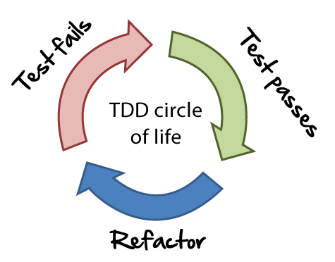
TDD workflow
red-green-refactor
Make it work. Make it right. Make it fast.
red-commit-commit-commit-green-refactor-push

Slide 39
„Secret tests”
Public vs private members
System is entitled to it’s „secrets” / implementation details !?
using Moq.Protected; var mock = new Mock<MyClass>(); mock.Protected() .Setup<int>("MyProtectedGetIntMethod") .Returns(1);

Slide 40
TDD vs BDD
TDD ≈ BDD - ⅓ of a difference ? ;-)
BDD != TDD
TDD for unit, BDD for integration
BDD == TDD done right

Slide 41
BDD == Given-When-Then ?
public void ValidOrderShouldBeFilled_WhenMarketIsFavourable() {
var orderId = Given .NewOrderIsSent(symbol: "VOD.L", quantity: 100);
When.MarketIsFavourableFor("VOD.L");
Then.OrderIsFilled(orderId); }
//Arrange
//Act
//Assert

Slide 42
BDD – Benefits
Shift Left – faster feedback
Stronger collaboration
Contract between analysts and tech
Ubiquitous language
Business
Tech

Slide 43
Summary
BEFRIEND AND „LOVE” YOUR TESTING FRAMEWORK
what you want your code to do and how your team want to use it
Composition over inheritance - IoC
code & test reviews
Prepare your own team tools & standards
FIRST, AAA
CI / CD / CD
„Live” unit tests
Symmetry tests

Slide 44
TDD Kata
https://github.com/garora/TDD-Katas/tree/master/src
https://github.com/ScioMx/TDD-Training

Slide 45
Q&A
Thank you for attention

